Slide 1
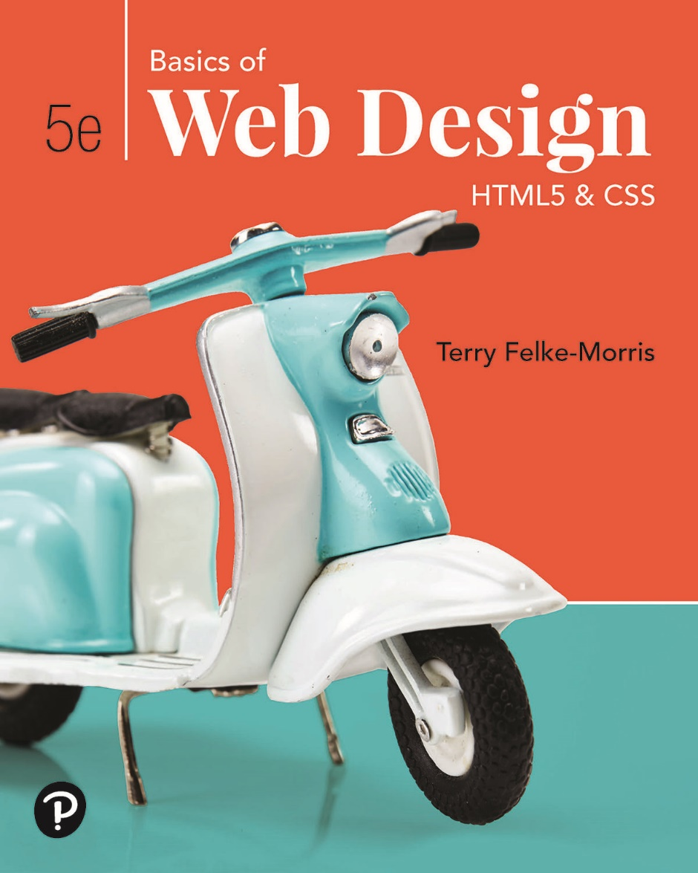
Basics of Web Design
Fifth Edition
Chapter 4
Cascading Style Sheets Basics Key Concepts
Slide in this Presentation Contain Hyperlinks. JAWS users should be able to get a list of links by using INSERT+F7
Copyright © 2019 Pearson Education, Inc. All Rights Reserved
Notes:
If this PowerPoint presentation contains mathematical equations, you may need to check that your computer has the following installed:
1) Math Type Plugin
2) Math Player (free versions available)
3) NVDA Reader (free versions available)

Slide 2
Learning Outcomes
Describe the purpose of Cascading Style Sheets
List advantages of using Cascading Style Sheets
Configure color on web pages with Cascading Style Sheets
Configure inline styles
Configure embedded style sheets
Configure external style sheets
Configure web page areas with element name, class, id, and descendant selectors
Test your C S S for valid syntax

Slide 3
Overview of Cascading Style Sheets (C S S)
See what is possible with C S S:
Visit http://www.csszengarden.com
Style Sheets
used for years in Desktop Publishing
apply typographical styles and spacing to printed media
C S S
provides the functionality of style sheets (and much more) for web developers
a flexible, cross-platform, standards-based language developed by the W 3 C.

Slide 4
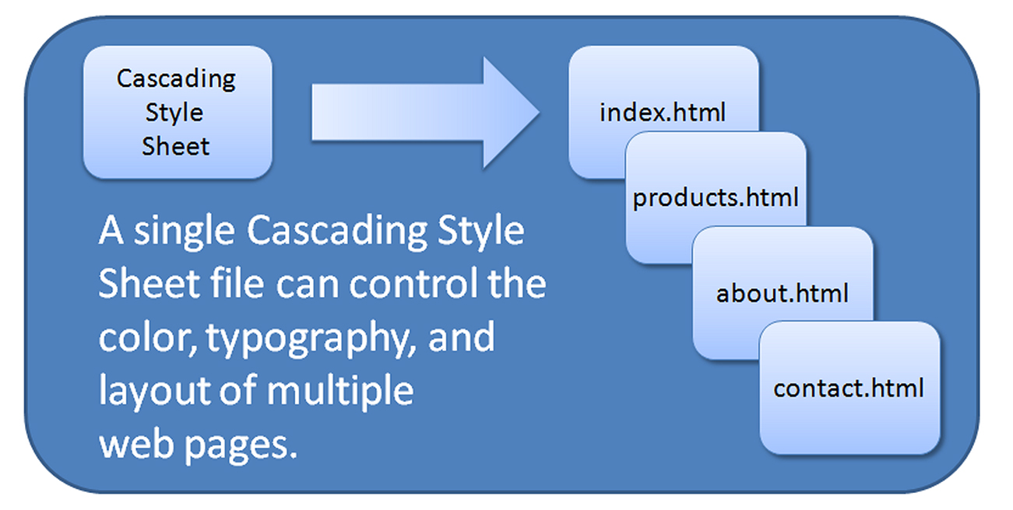
C S S Advantages
Greater typography and page layout control
Style is separate from structure
Styles can be stored in a separate document and associated with many web pages
Potentially smaller documents
Easier site maintenance

Slide 5
Types of Cascading Style Sheets
Inline Styles
Embedded Styles
External Styles
Imported Styles

Slide 6
Description of the Types of Cascading Style Sheets
Inline Styles
Configured in the body of the web page
Use the style attribute of an H T M L tag
Apply only to the specific element
Embedded Styles
Configured in the head section of a web page.
Use the H T M L <style> element
Apply to the entire web page document
External Styles
Configured in a separate text file with .css file extension
The H T M L <link> element in the head section of a web page associates it with the .css file
Imported Styles
Similar to External Styles
We’ll concentrate on the other three types of styles.

Slide 7
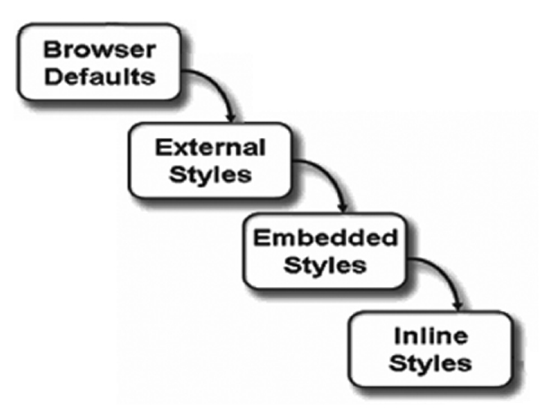
The “Cascade”

Slide 8
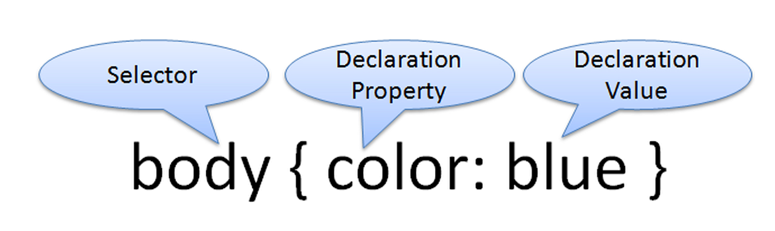
C S S Syntax
Style sheets are composed of "Rules" that describe the styling to be applied.
Each rule contains a Selector and a Declaration

Slide 9
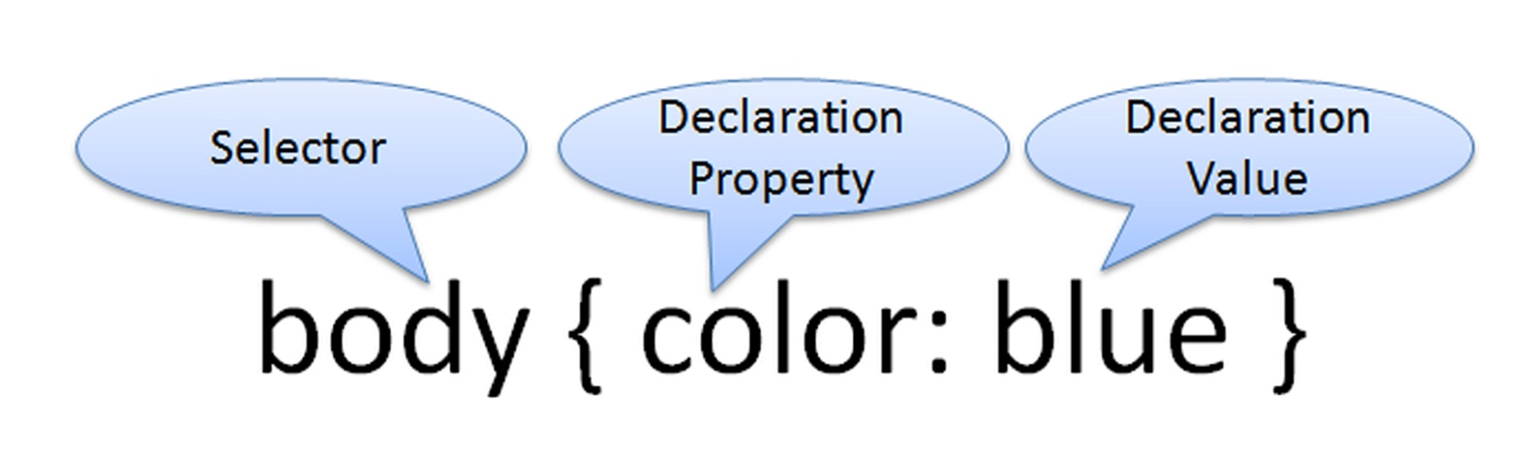
C S S Syntax Sample
Configure a web page to display blue text and yellow background.
body { color: blue;
background-color: yellow; }
This could also be written using hexadecimal color values as shown below.
body { color: #0000F F;
background-color: #F F F F00; }

Slide 10
C S S Syntax for Color Values
Table 4.2 Syntax to configure a paragraph with red text
C S S Syntax | Color Type
p { color: red } | Color name
p { color: #F F0000 } | Hexadecimal color value
p { color: #F00 } | Shorthand hexadecimal (one character for each hexadecimal pair – only used with web safe colors)
p { color: rgb(255,0,0) } | Decimal color value (R G B triplet)
p { color: rgba(255,0,0,0.5) } | Decimal color value (R G B triplet) followed by the alpha opacity (a value from 0 to 1).
p { color: hsl(0, 100%, 50%) } | HSL color values.
Notes:
HSL stand for Hue, Saturation, Lightness: color value notation new in CSS3.

Slide 11

Inline C S S with the Style Attribute
Inline C S S
Configured in the body of the Web page
Use the style attribute of an H T M L tag
Apply only to the specific element
The Style Attribute
Value: one or more style declaration property and value pairs
Examples
<h1 style="color:#ff0000">Heading text is red</h1>
<h1 style="color:#F F0000;background-color:#cccccc">This is displayed as a red heading with gray background</h1>

Slide 12
Configure Embedded C S S with the Style Element
Configured in the head section of a web page.
Use the H T M L <style> element
Apply to the entire web page document
Style declarations are contained between the opening and closing <style> tags
The optional type attribute indicates the M I M E (Internet media type) type of text/css
Example:
<style>
body { background-color: #000000;
color: #F F F F F F;
}
</style>

Slide 13
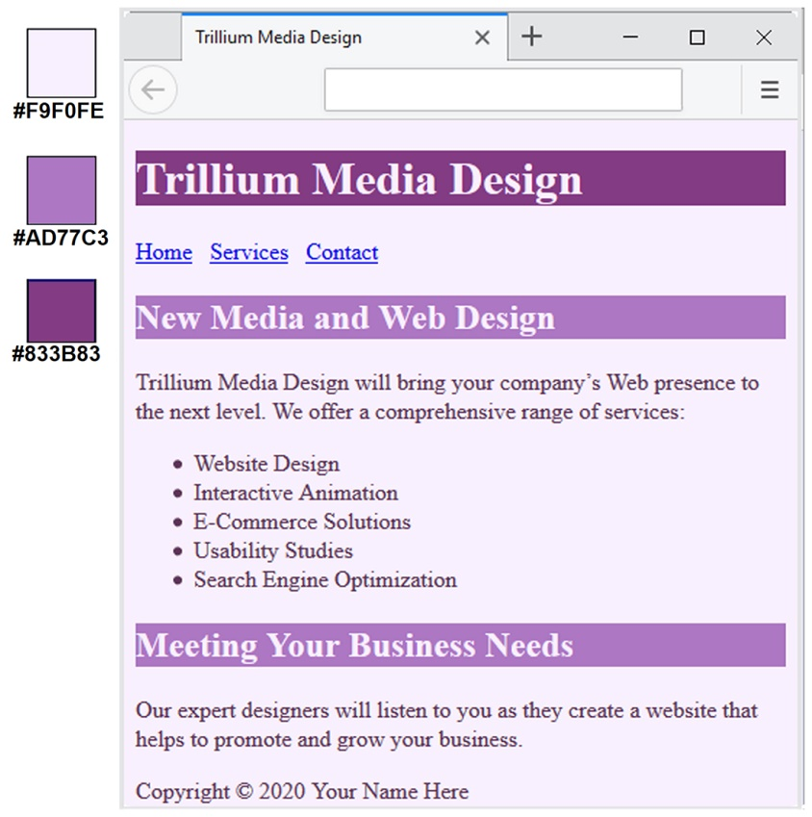
C S S Embedded Styles
The body selector sets the global style rules for the entire page.
These global rules are overridden for <h1> and <h2> elements by the h1 and h2 style rules.
<style>
body { background-color: #E 6 E 6 F A;
color: #191970; }
h1 { background-color: #191970;
color: #E6E6FA; }
h2 { background-color: #A E A E D 4;
color: #191970; }
</style>

Slide 14
External Style Sheets - 1
C S S style rules are contained in a text file separate from the H T M L documents.
The External Style Sheet text file:
extension ".css"
contains only style rules
does not contain any H T M L tags

Slide 15
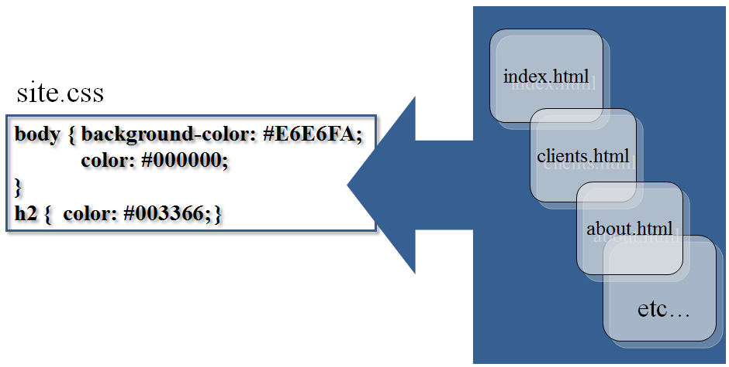
External Style Sheets - 2
Multiple web pages can associate with the same external style sheet file.

Slide 16
The <link> Element
A self-contained tag (void)
Placed in the header section
Purpose: associates the external style sheet file with the web page.
Example:
<link rel="stylesheet" href="color.css">

Slide 17
Using an External Style Sheet
External Style Sheet color.css
body { background-color: #0000F F;
color: #F F F F F F;
}
To associate with the external style sheet called color.css, place the following code in the head section:
<link rel="stylesheet" href="color.css">

Slide 18
C S S Selectors
Common Types of Selectors:
H T M L element name selector
class selector
id selector
descendant selector

Slide 19
Using C S S with “class”
class Selector
Apply a C S S rule to ONE OR MORE elements on a web page
Does not associate the style to a particular H T M L element
Configure with .classname
The sample creates a class called “new” with red text.
To use the class, code the following H T M L:
<style>
.new { color: #F F0000;
}
</style>
<p class="new">This text is red</p>
This text is red.

Slide 20
Using a C S S id Selector
id Selector
Apply a C S S rule to ONLY ONE element on a web page.
Configure with #idname
The sample creates an id called “new” with red text.
To use the id, code the following H T M L:
<style>
#new { color: #F F0000;
}
</style>
<p id="new">This text is red.</p>
This text is red.

Slide 21
Using a C S S Descendant Selector
Descendant Selector
Apply a C S S rule within the context of the container (parent) element.
Sometimes called a contextual selector.
Configure by listing the container selector followed by the selector you are styling.
The sample specifies a green text color for only the paragraph elements located within the footer element.
<style>
footer p {color: #00ff00; }
</style>

Slide 22
The Span Element <span>
An inline-level element
Purpose:
Configure a specially formatted area displayed in-line with other elements, such as within a paragraph.
There is no line break before and after the span.

Slide 23
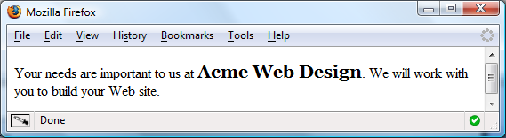
<span> Example
Embedded C S S:
<style>
.companyname { font-weight: bold;
font-family: Georgia, "Times New Roman", serif;
font-size: 1.25em; }
</style>
H T M L:
<p>Your needs are important to us at <span class=“companyname">Acme Web Design</span>. We will work with you to build your website.</p>

Slide 24
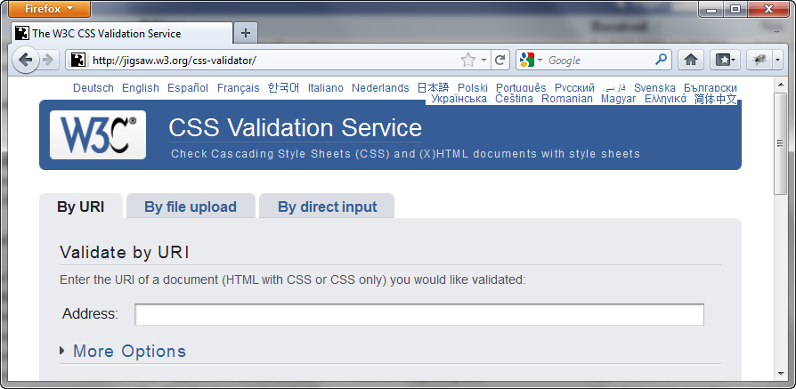
W 3 C C S S Validation
http://jigsaw.w3.org/css-validator

Slide 25
C S S Troubleshooting Tips
Verify you are using the : and ; symbols in the right spots—they are easy to confuse.
Check that you are not using = signs instead of : between each property and its value.
Verify that the { and } symbols are properly placed
Check the syntax of your selectors, their properties, and property values for correct usage.
If part of your C S S works, and part doesn’t:
Review your C S S
Determine the first rule that is not applied. Often the error is in the rule above the rule that is not applied.
Validate your C S S at http://jigsaw.w3.org/css-validator

Slide 26
Summary
This chapter introduced you to Cascading Style Sheet Rules associated with color on web pages.
You configured inline styles, embedded styles, and external styles.
You applied C S S style rules to H T M L, class, and id selectors.
You are able to submit your C S S to the W 3 C C S S Validation test.

Slide 27

Copyright
This work is protected by United States copyright laws and is provided solely for the use of instructors in teaching their courses and assessing student learning. Dissemination or sale of any part of this work (including on the World Wide Web) will destroy the integrity of the work and is not permitted. The work and materials from it should never be made available to students except by instructors using the accompanying text in their classes. All recipients of this work are expected to abide by these restrictions and to honor the intended pedagogical purposes and the needs of other instructors who rely on these materials.

